Slide 1
See separate .xls file
Supplemental Data Set 1. Mean of B. cinerea lesion size of all isolates across all tomato accessions.

Slide 2
See separate .xls file
Supplemental Data Set 2. Gene and Function Annotation from T4 GWA Results
a) Genes with significant SNPs from bigRR on T4 for Botrytis virulence in 11 or 12 of the tomato accessions.
b) Functional categories significantly overrepresented in genes linked to Botrytis virulence response to tomato domestication by bigRR on T4.

Slide 3
See separate .xls file
Supplemental Data Set 3. Results of single-isolate ANOVA on mixed effect model
Results of general linear modelling of lesion area within each of the 95 B. cinerea isolates are shown. The terms are as follows; Domestication is wild tomato, S. pimpinellifolium, versus domesticated tomato, S. lycopersicum, Plant is 12 tomato genotypes nested within their respective domestication groupings, Experiment tests the random effect of 2 independent replicate experiments. The Chi squared value, degrees of freedom, p-value, and FDR-corrected p-value are shown for each fixed effect term in each isolate model.

Slide 4
Fixed Effect | % genetic variance | SS | F value | DF | p |  | Mean lesion area:
Isolate | 13.5 | 36.5 | 1.7 | 92 | 0.009 |  | Domesticated | 0.725
Domestication | 1.2 | 3.2 | 13.4 | 1 | 0.0008 |  | Wild | 0.62
Domest/Plant | 15.2 | 41.1 | 17 | 10 | 4.3 x 10⁻¹¹
Iso:Domest | 5.7 | 15.3 | 0.7 | 92 | 0.99
Iso:Domest/Plant | 64.4 | 173.8 | 0.8 | 920 | 1
Random Effect | LRT | DF | p
1 | Experiment | 134.3 | 1 | < 2.0 x 10⁻¹⁶
1 | Whole Plant | 0.029 | 1 | 0.86
1 | WP/Leaf | 24.4 | 1 | 7.7 x 10⁻⁷
1 | WP/Leaf/Leaflet Pair | 0 | 1 | 1
1 | Exp:Iso | 308.6 | 1 | < 2.0 x 10⁻¹⁶
Supplemental Table 1. Results of ANOVA following removal of domestication-associated isolates
Results of general linear modelling of lesion area for 12 tomato accessions by 93 B. cinerea isolates is shown (R lme4 package version 1.1-18-1;(Bates, Maechler et al. 2015)). This analysis includes the full 95 isolate sample, without the two domestication-associated isolates (Fd2, Rose). The terms are as follows; Isolate is the 93 B. cinerea isolates, Domestication is wild tomato, S. pimpinellifolium, versus domesticated tomato, S. lycopersicum, Plant is 12 tomato genotypes nested within their respective domestication groupings, Experiment tests the random effect of 2 independent replicate experiments. The nested random effects of whole plant sampled, leaf sampled, and leaflet pair are included. In addition, interactions of these factors are tested (:). The degrees of freedom and p-value are shown. For fixed effects, the type II sum of squares and F-value are shown, and for random effects the likelihood ratio test statistic (LRT) is shown.

Slide 5
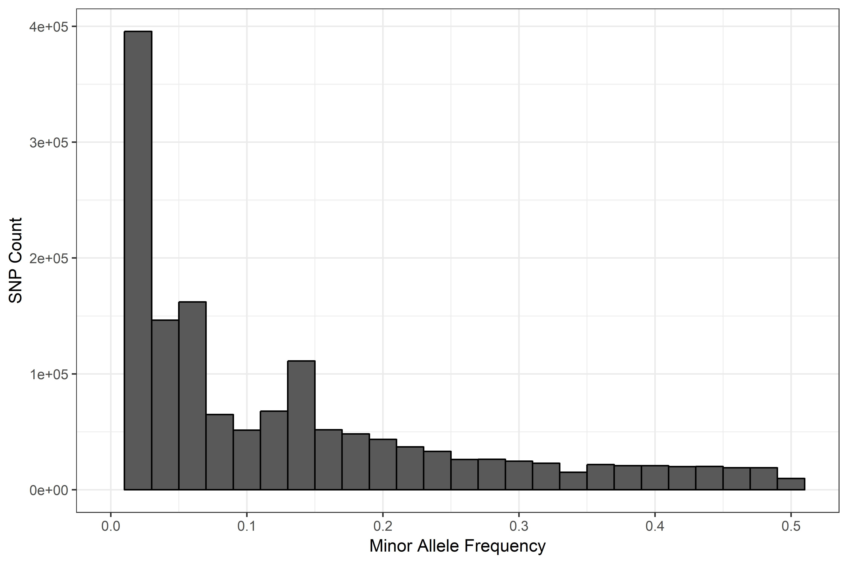
4 x 10⁵
3 x 10⁵
2 x 10⁵
1 x 10⁵
0
0
Supplemental Figure 1. Allele frequency spectrum of B. cinerea SNPs.
Minor allele frequency is calculated across 97 isolates including our GWA population, at 1,048,575 SNPs including the 272,672 used in our analysis.

Slide 6
Cluster Dendrogram

Slide 7
Supplemental Figure 2. Genetic distance between selected tomato accessions. Pairwise Euclidean distances between 426 wild and domesticated tomato accessions in the SolCAP diversity panel calculated from Infinium SNP genotyping at 7,720 loci (Sim 2012). Clustering is by R hclust's default UPGMA method. S. pimpinellifolium accessions in the current study are marked with orange stars, S. lycopersicum accessions in the current study are marked with blue stars. All of the wild S. pimpinellifolium included in this panel cluster with our 3 accessions. Mean ± SE of lesion size of B. cinerea across the full study is included for each accession. Supports tomato accession summary in Figure 2.

Slide 8
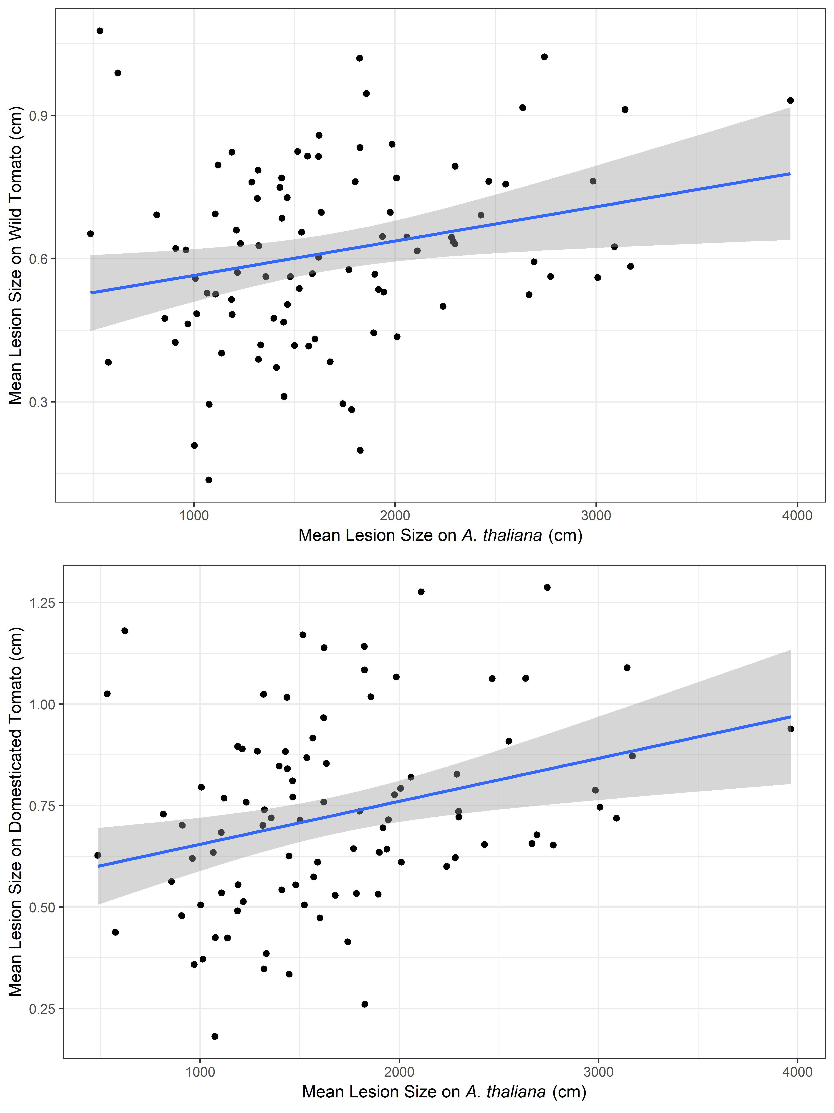
Supplemental Figure 3. Correlation between B. cinerea lesion size on tomato and on A. thaliana. Lesion size of 94 of our B. cinerea isolates on tomato was weakly correlated with lesion size on A. thaliana from previous studies (Zhang 2017); both on domesticated tomato (r=0.247, p= 0.003) and on wild tomato (r=0.301, p= 0.016). Supports lesion size variation across species in Figure 3.

Slide 9
Supplemental Figure 4. Rank order plot of B. cinerea lesion size on two tomato genotypes.
Each B. cinerea isolate is a straight line tracing mean lesion size on LA1547 to mean on LA0410, the two host genotypes with the most pronounced effect on the rank order of isolates by lesion size (Wilcoxon signed-rank test with FDR-correction, p = 3.33 x 10⁻¹⁷, Table 2).

